Slide 1

Biology 112 – Evolution, Form and Function of Organisms
Instructor – Jean Everett, PhD
This is a foundation course designed for majors – are you sure you are in the right place???
Even if you took 111, you don’t have to take 112……

Slide 2
This is me; please pay attention
http://video.nationalgeographic.com/video/short-film-showcase/his-epic-message-will-make-you-want-to-save-the-world?cs=related&source=relatedvideo

Slide 3
Syllabus Details
Note office hours
  Always call or resend if I don’t respond to email
Text details
  Freeman, 6th or 7th edition; OpenStax Biology 2e
  Grades and exams
Attendance and promptness are mandatory
  Note that quizzes are not announced
  We are back to our normal attendance policies – see syllabus. Remember, you can’t learn if you are not present

Slide 4
Use the Web Pages!!! http://everettj.people.cofc.edu/BIOL112.html
Announcements
Supplemental Instruction schedule
Lecture outlines
PowerPoints (without images, but I’ll have a binder)
Tips and links to help you study – use these!!!
Extra credit opportunities

Slide 5
Use the Web Pages!!!
OAKS
Announcements
Supplemental Instruction schedule
Zoom Links
OAKS gradebook will be indicative, NOT final

Slide 6
Attend Supplemental Instruction
Start going right away!!! Mandatory once in the first 2 weeks (= first quiz grade)
These are peer-to-peer work sessions
They will both sharpen your study skills and deepen your understanding of the material
Our SI leaders have taken and excelled in this course – Shem is particularly effective!
They have learned how to apply knowledge to complex exam questions!!!
Activities that will help you learn how to work through the complicated, application oriented questions that are typical of my exams so that YOU TOO can become successful!!!
Notes:
Ask if they know about the SI program; introduce Madison

Slide 7
More syllabus details
Lecture schedule is tentative
Exams WILL NOT move, barring disaster
  Mark them on your calendar NOW
We may adjust the material covered but we will not move the exams
Notes:
Barring disasters, hurricane days, etc

Slide 8
My Teaching Philosophy
Learning is a cooperative effort
A joint venture between YOU and ME
We are colleagues!
My job is to present material with clarity and organization, challenge you to think, answer your questions, test you fairly
What are your responsibilities?????
Notes:
Ask them their responsibilities

Slide 9
Only YOU can learn
Attend class
Stay focused in class – be HERE
Prepare, prepare, prepare
  This is a time consuming class
  A broad survey of a complex subject
Ask questions!!! If you are confused, so are other students
  This class works much better with interactive students
Think!!!
Be respectful of your fellow students
  Be prompt, do not chitter-chatter in class, no cell phones or inappropriate use of other electronic devices
  These are NON-NEGOTIABLE RULES in our class

Slide 10
College is different from high school!!!
Memorization is NOT enough
Must make the transition to putting disparate bits of information together to build a coherent understanding so that you can answer new questions
Learning in college is self-directed!!!
  No homework, no worksheets…..just the syllabus, the text, your extra options, and YOU
Can be a hard, scary transition

Slide 11
Course Objectives
To improve your skills in critical, scientific thinking and logical reasoning
  We can’t learn all of biology, but we can learn to think like a biologist!
To give you an introductory foundation
  The processes of evolution
  How evolution has resulted in both unity and diversity in organisms – will be a constant theme
  The basic structure and function of the 2 most diverse groups of multi-cellular organisms – the plants and the animals
Have fun learning about the exciting world of biology!!!

Slide 12
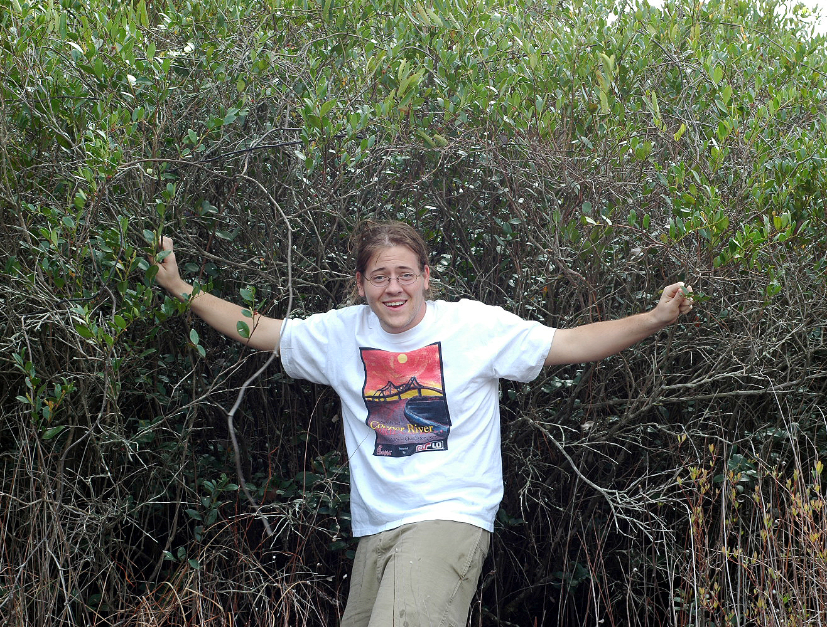
Are we having fun yet????? Learning should be fun!!!!

Slide 13

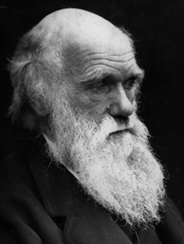
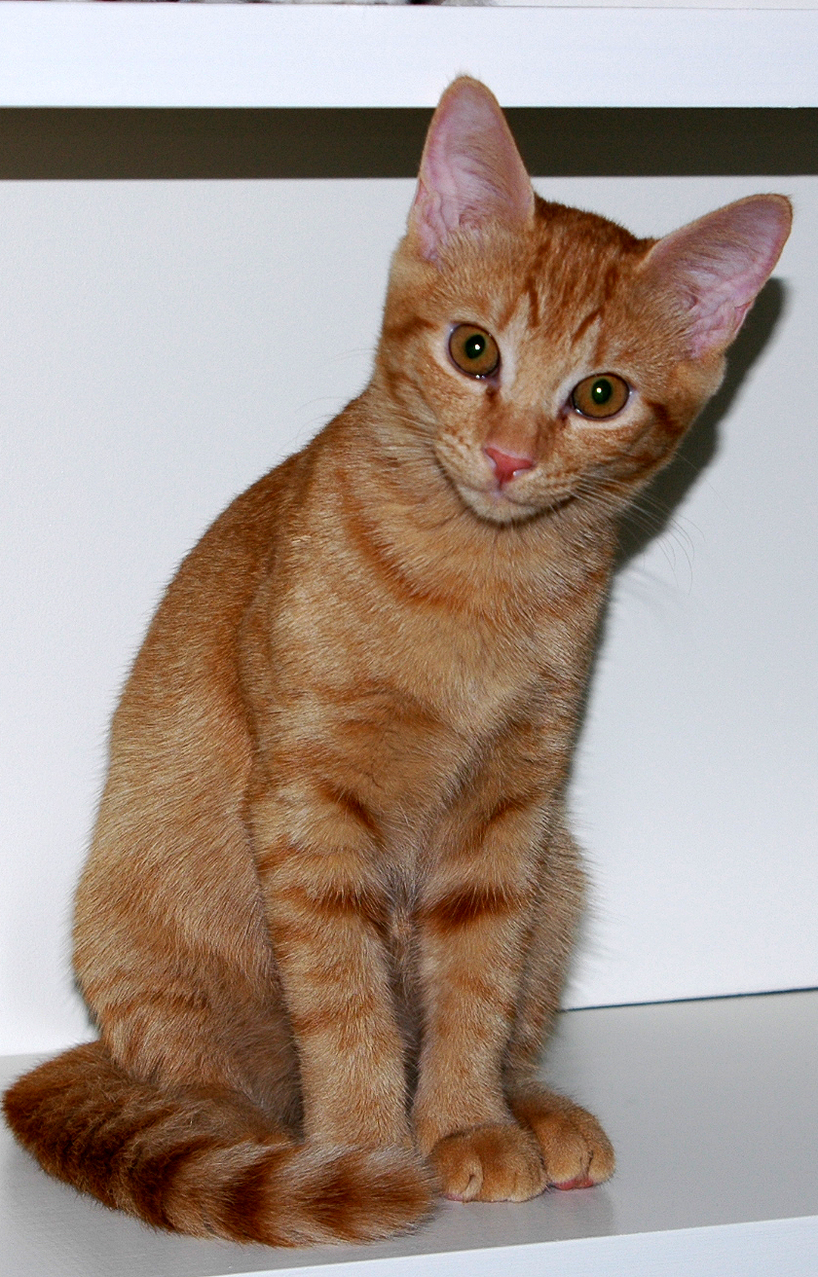

Three Major Sections
Evolution – the foundation of modern biology
Structure and function of plants
Structure and function of animals
Pine Lily Charles Darwin Buttercup and Grace

Slide 14
Options for Help
Use the Center for Student Learning
  SI – one of your most valuable resources
  Tutors
  Study labs
  Meet with me – Zoom only this semester!
Take a minute to meet classmates, exchange phone #'s
  This will be hard this semester, but try!
  Start forming study partnerships NOW
Any questions about me?

Slide 15
Any Questions???
Notes:
Tell my background

